Slide 1
Wesley Young’s PIG
Logos
layouts for your pages
Color Scheme ideas

Slide 2


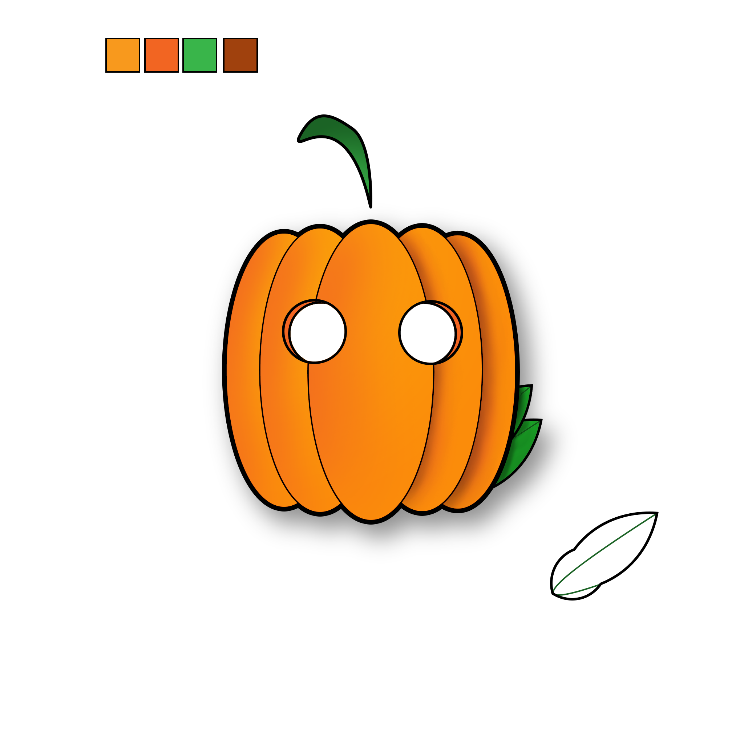


Logos
“homemade” logo from photoshop
Two ai logos
Hollowed logos

Slide 3
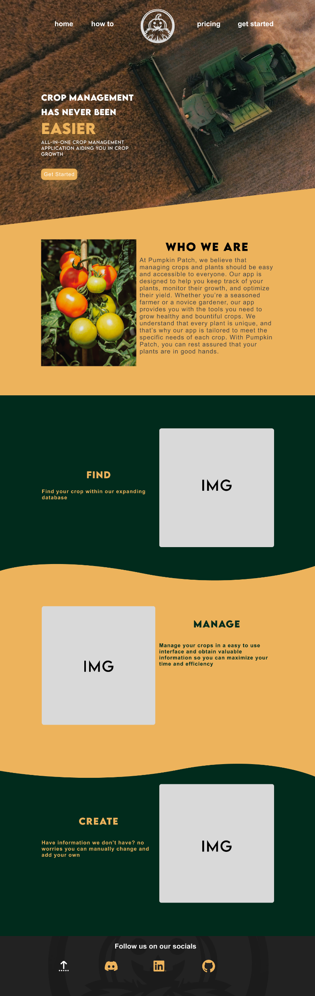
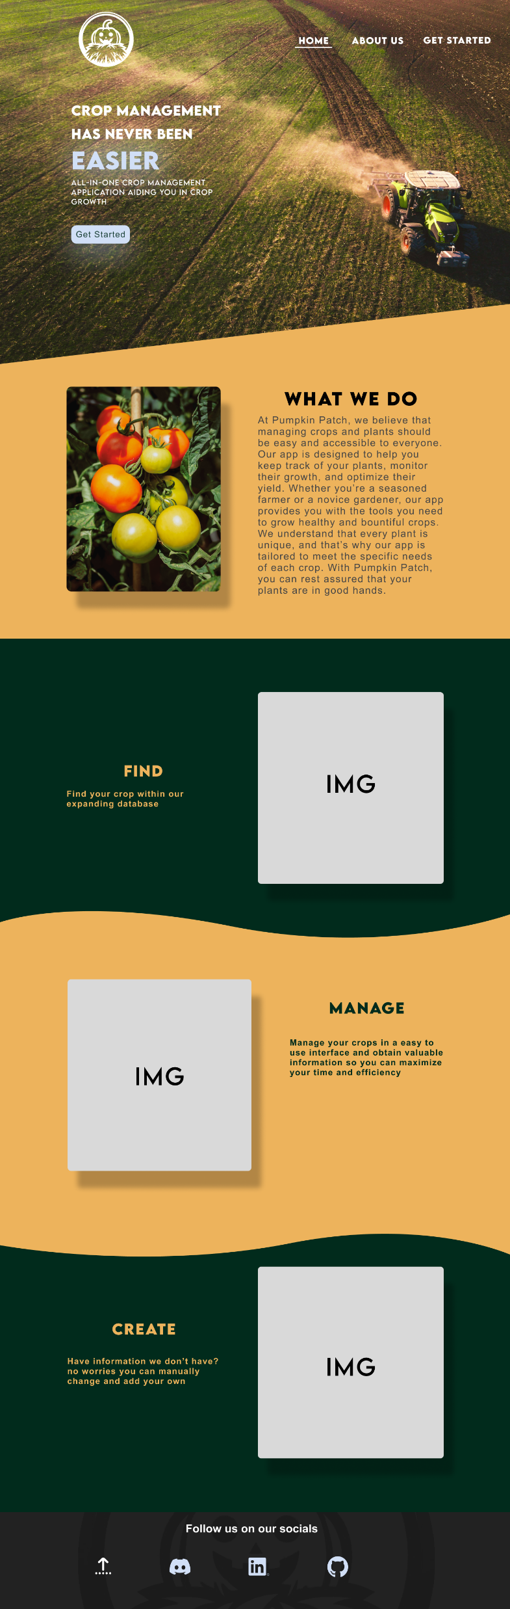
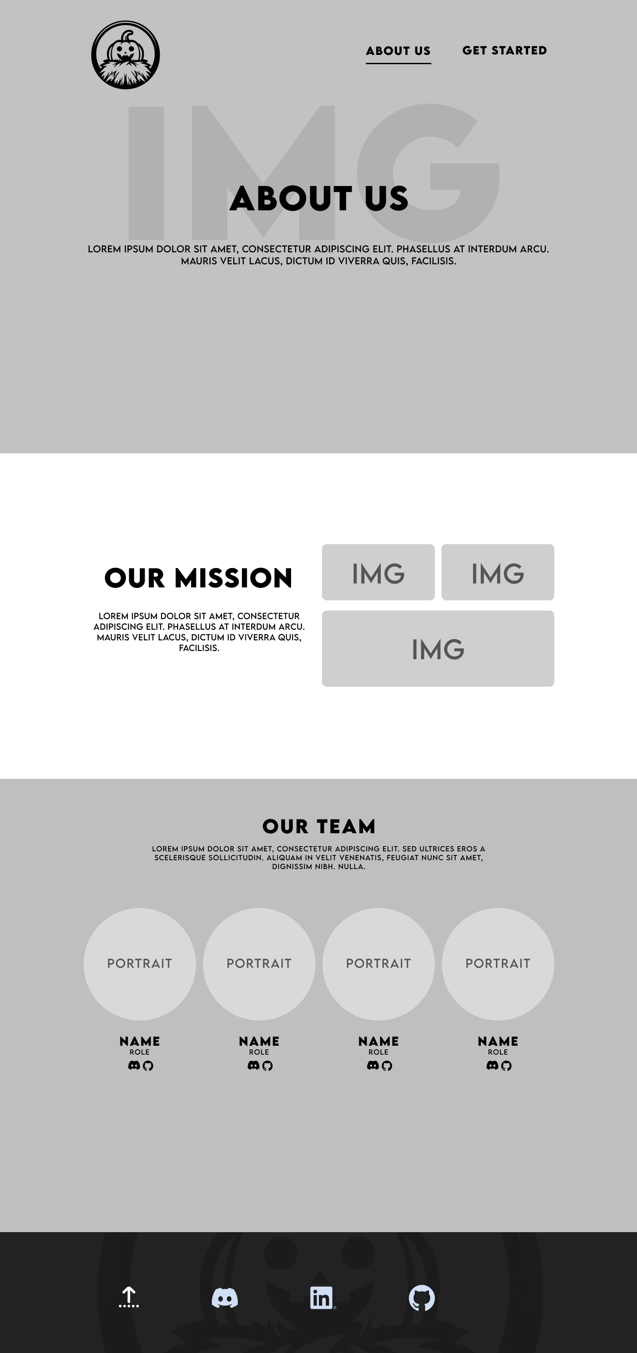
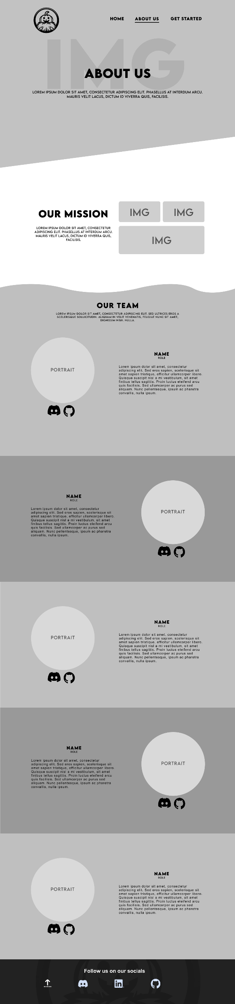
Layouts
Home page 1
Home page 1.5
About Us 1
About Us 1.5

Slide 4
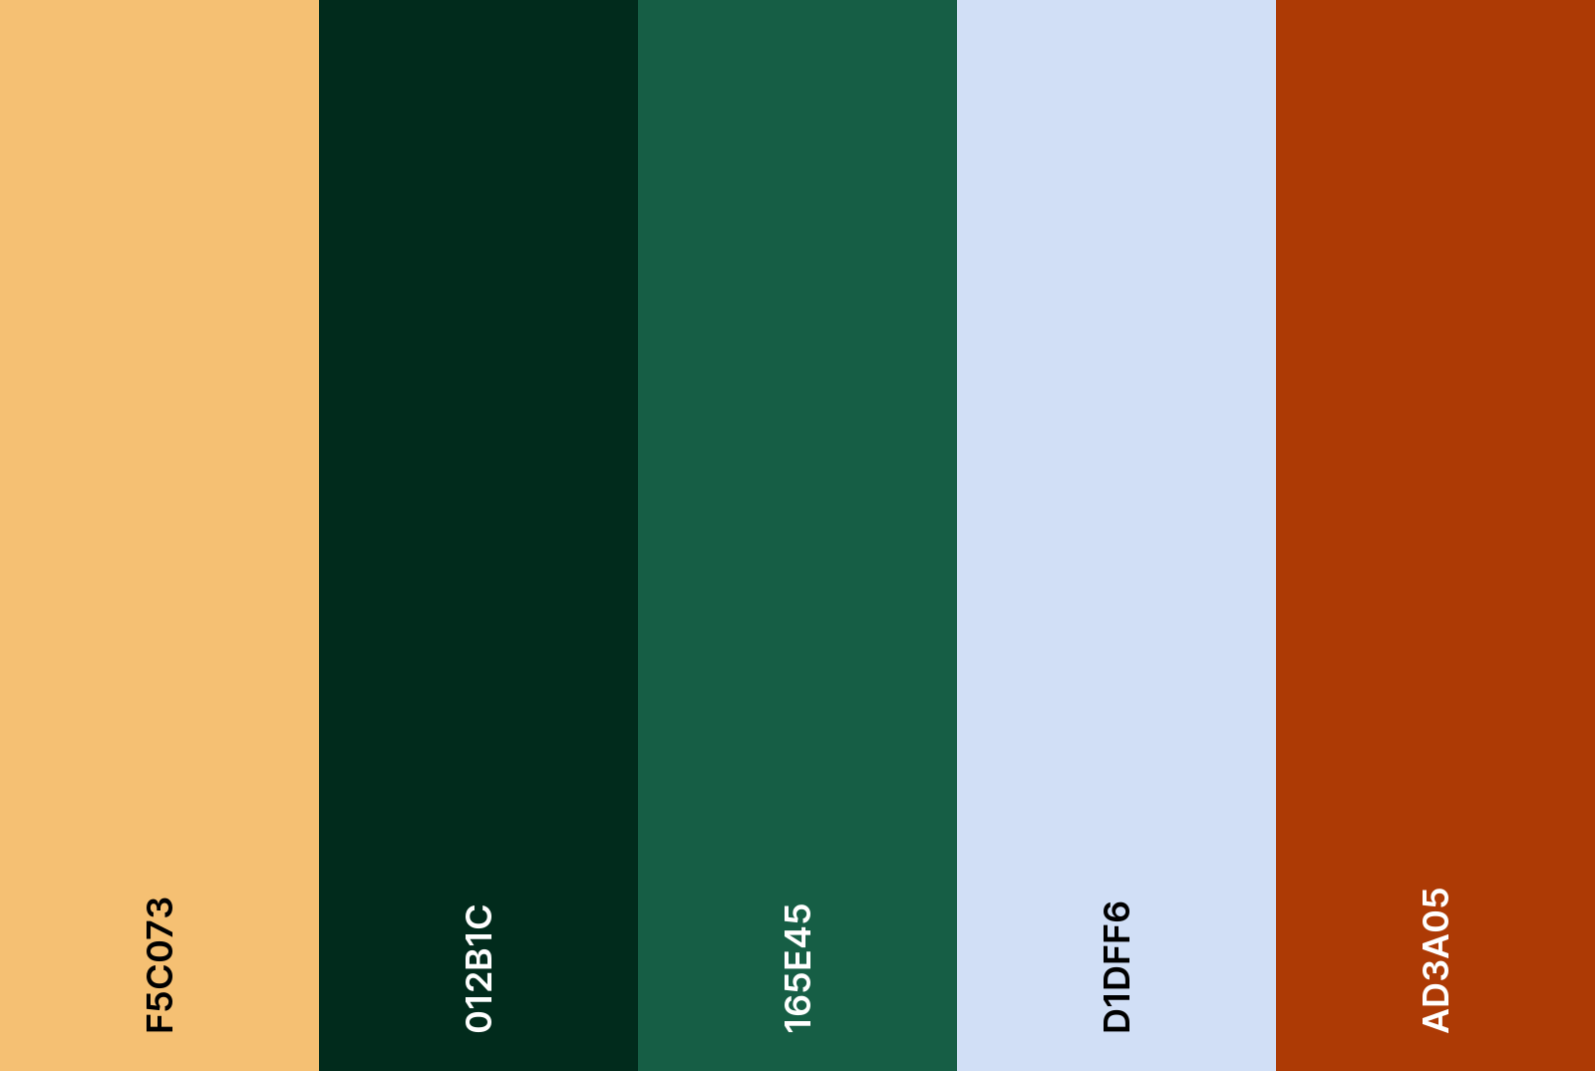
Current Color scheme

